Slide 1
Grants.gov Applicant Overview
Version: Grants.gov Release 18.2

Slide 2
Training Topics
Navigating Grants.gov
Registration
Search Grants
What’s In a Funding Opportunity?
Applying with Workspace
Track Application Submission
Tips and Support Resources

Slide 3
Navigating Grants.gov

Slide 4
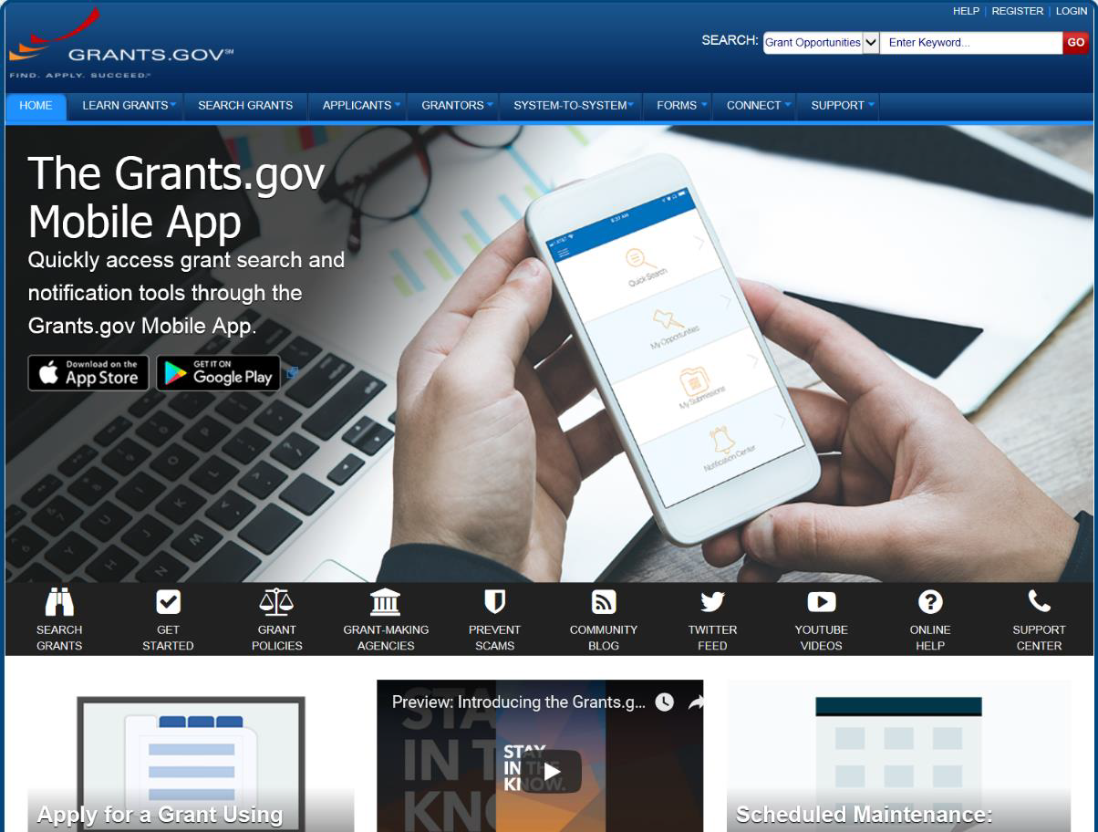
Navigating Grants.gov
Search Grants and Applicant Tabs on the Homepage

Slide 5
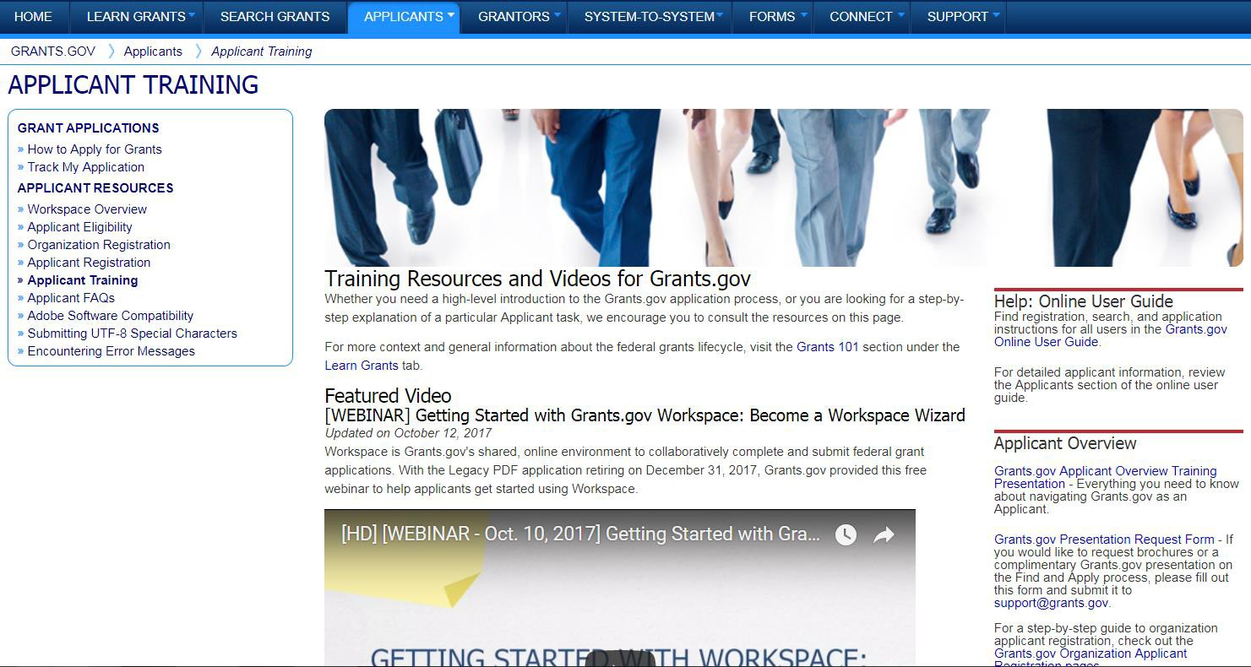
Navigating Grants.gov
Applicant Resources: Videos, User Guide, Training Content, FAQs and More

Slide 6
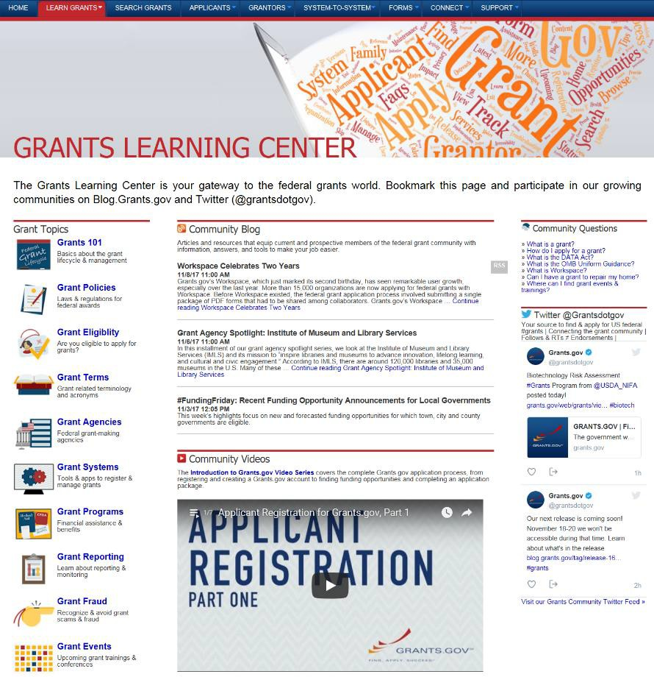
Navigating Grants.gov
Highlights from the Learn Grants tab
Grants 101: An introduction to the key
phases of the federal grant lifecycle
Grant Policies: Summaries and tables explaining how federal grant policies are formed
Grant Terminology: Essential terms and definitions from the Common Data Element Repository Library (CDER Library)
Grant Events: Upcoming grant trainings,
conferences, and webinars

Slide 7
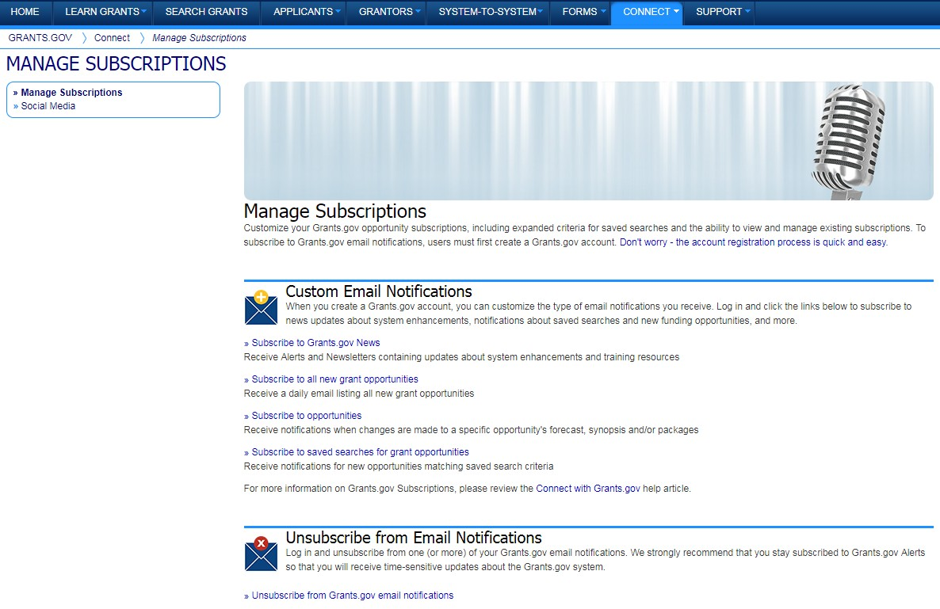
Navigating Grants.gov
Subscriptions and Email Notifications

Slide 8
Registration

Slide 9
Registration: Before Grants.gov
System for Award Management (SAM.gov)
Register with SAM at www.SAM.gov to receive UEI
Establish Electronic Business Point of Contact (EBiz POC): Individual who oversees all activities for organization within Grants.gov and approves the AOR
~7-10 (or more) business days after completely registering, including submitting notarized letter to SAM

Slide 10
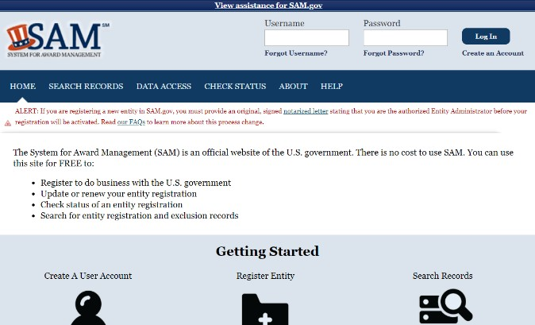
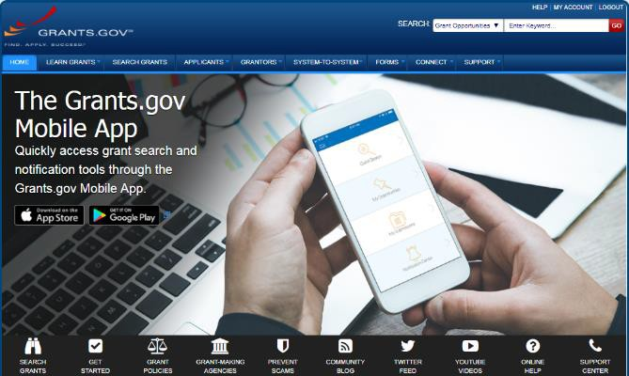
Registration:
SAM.gov and Grants.gov
Organization data and EBiz POC information are transferred electronically from SAM to Grants.gov
Applicants within the organization can add a new profile to their account to associate with the organization
Visit SAM.gov for more information: https://sam.gov/content/home
NOTE: SAM registration must be renewed annually

Slide 11
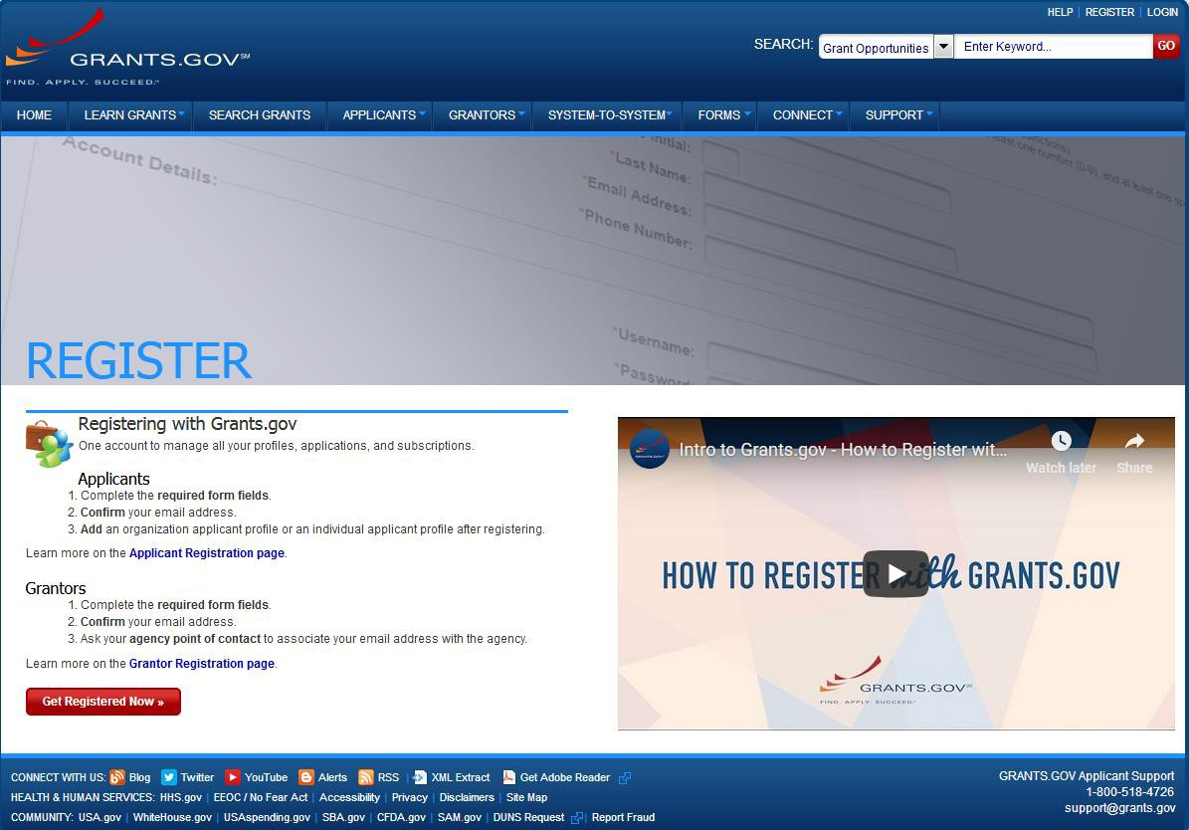
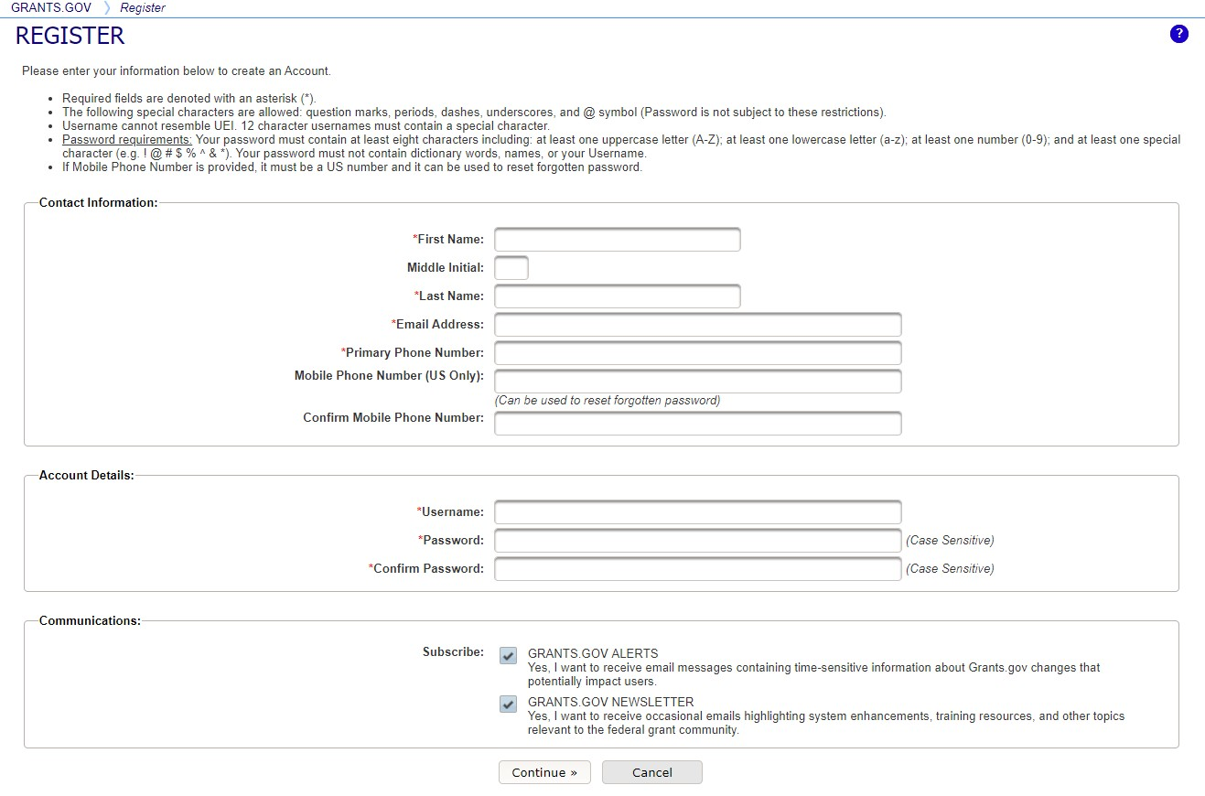
Registration: Grants.gov Account
Accounts enable subscription management
1
3
2

Slide 12
Registration: Grants.gov Roles
EBiz Point of Contact, AOR role, workspace manager role
Users with standard AOR role can submit applications
Expanded AOR
One organization can have many users in each role
Each organization
has one EBiz POC
EBiz POCs assigned in SAM.gov
User with an EBiz POC email address is automatically assigned an expanded AOR role, which allows them to delegate roles.
Users with workspace manager role can create workspaces

Slide 13
Search Grants

Slide 14
Searching for Funding Opportunities
Using the Grants.gov Search Fields

Slide 15
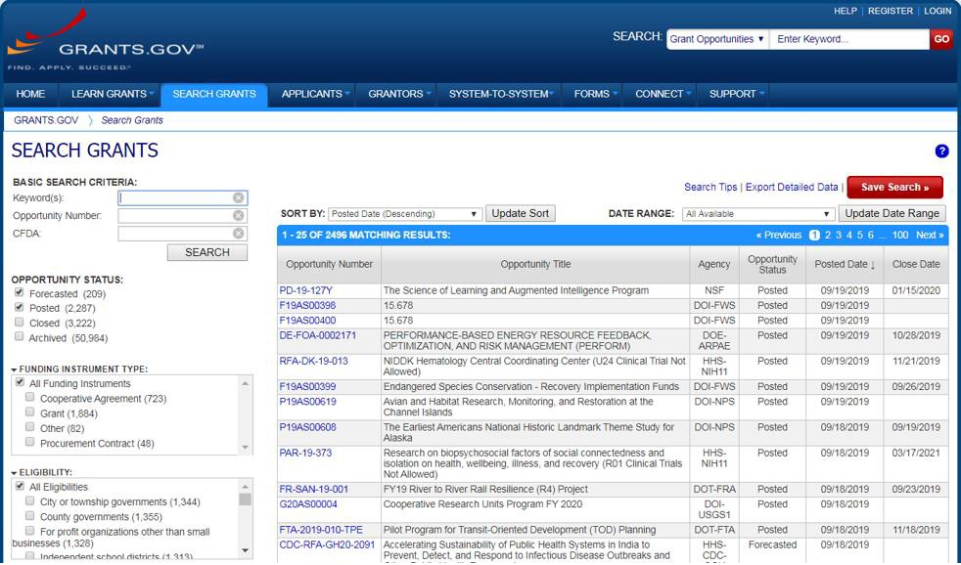
Searching for Funding Opportunities
Find – Basic Search
Search for grants and forecasts by entering a keyword.
In Search Grants tab,
search by:
Keyword
Opportunity Number
CFDA Number or Title

Slide 16
Searching for Funding Opportunities
Opportunity Status
Select the Opportunity
Status to find what you
are looking for:
Forecasted - Potential grants in the near future
Posted - Currently
open grants
Closed - Recently
ended grants
Archived - Past grants
available for reference

Slide 17
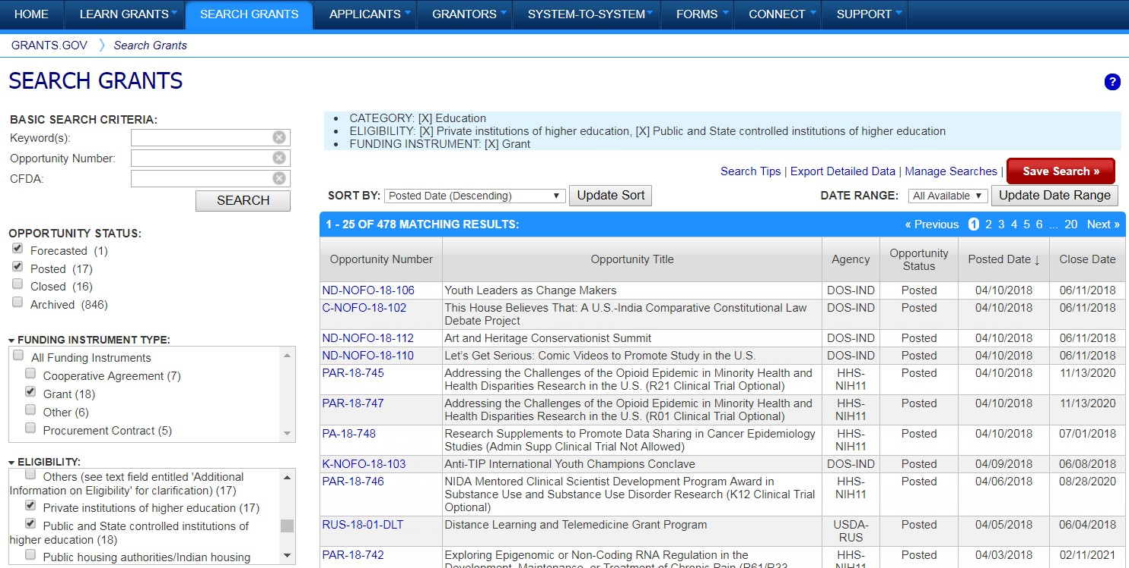
Searching for Funding Opportunities
Sign In and Save Your Search
Refine your search by selecting criteria options:
Category
Eligibility
Funding Agency
Opportunity Status
Date ranges
Click Save Search button to store this set of search criteria to receive emails
Click Manage Searches link to review your saved searches

Slide 18
What’s in a Funding
Opportunity?

Slide 19
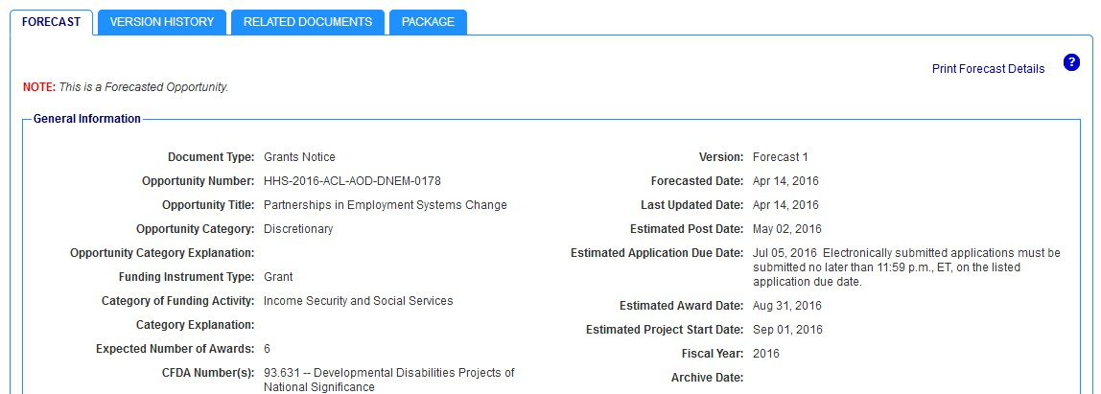
What’s in a Funding Opportunity?
Forecast
A Forecast is a projection of an estimated funding
opportunity. Contains information, such as:
Estimated Post and Due Dates
Estimated Program Funding Amount
Estimated Award Date

Slide 20
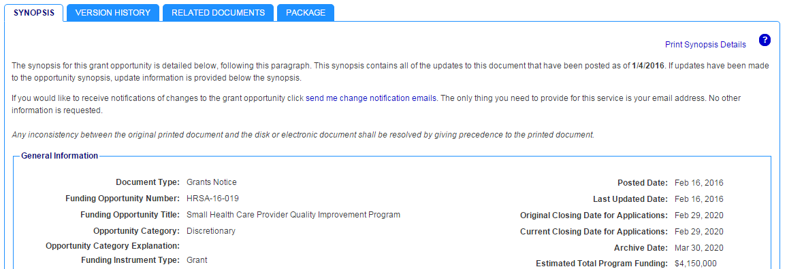
What’s in a Funding Opportunity?
Synopsis
The Synopsis contains basic information about the funding opportunity, such as:
Funding Opportunity
Number
Open/Close date
Program Funding
Amount
Number of Awards

Slide 21
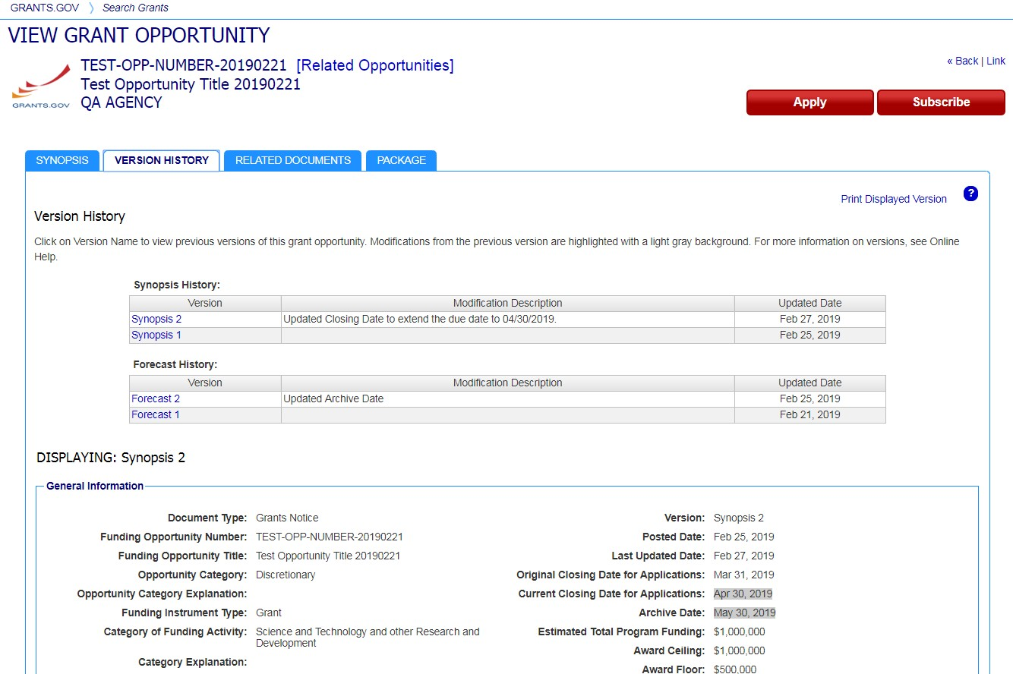
What’s in a Funding Opportunity?
Version History
The Version History displays a table with synopsis modifications
To display an earlier version, the user clicks on the desired Version Name
The fields modified are
highlighted in gray

Slide 22
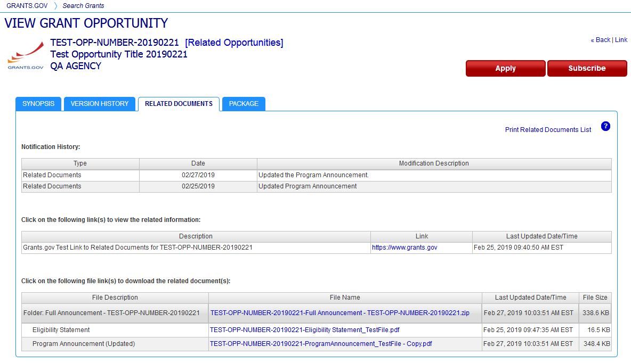
What’s in a Funding Opportunity?
Full Announcement – Under Related Documents Tab
You can retrieve the fu l Funding Opportunity Announcement (FOA), Request for Applications (RFA), and any supplementary documentation

Slide 23
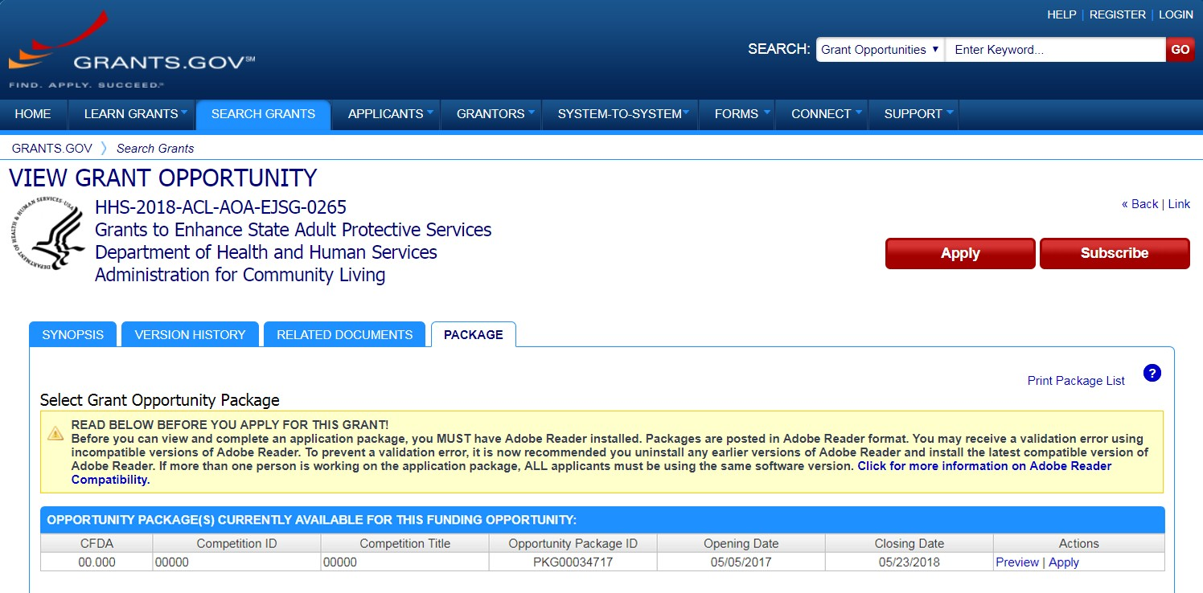
What’s in a Funding Opportunity?
Workspace Application and Instructions
Click the Package tab to preview the application package forms
Log in to create a workspace to apply
Sign up for emails of changes made to this funding opportunity
Click Preview link to access read-only forms and application instructions
*Any Closed packages associated with the FOA will be listed near the bottom of
the Package tab, within a separate grid. No “Apply” action will be available.

Slide 24
Applying with Workspace

Slide 25
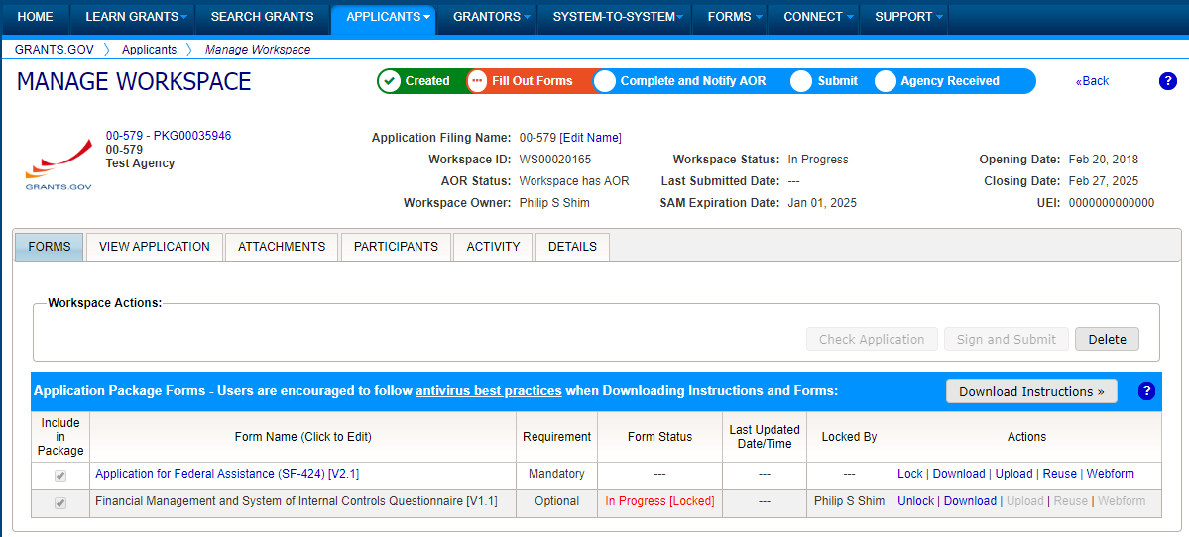
What Is Grants.gov Workspace?
The online space on where you work on your grant application
Workspace is a shared, online environment where members of a grant team may simultaneously access and fill out forms within an application.

Slide 26
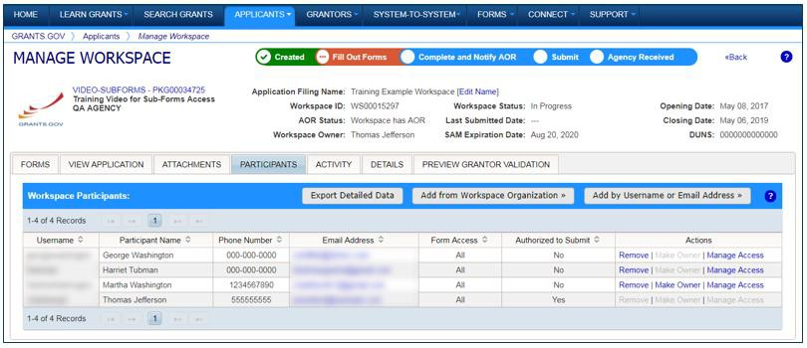
Workspace: Participants
The Participants tab lists the members, or “Participants,” of a workspace who work as a team to complete the required forms for a federal grant.

Slide 27
Workspace: Participants
Account Types:
E-Business Point of Contact (EBiz POC) Assigns roles to Organization members
Applicant (AOR) Submits applications
Access Levels:
Workspace Manager (WM) Creates Workspace and Adds Participants to Workspace
Workspace Participant has no
specific roles

Slide 28
Workspace: WM Adds Participants
Adding Participants:
Click the Add from Workspace Organization button to search for a user within your organization
Click the Add by Username or Email Address button to add a user from outside your organization
Removing Participants:
Click the Remove link on the
Participant record in the workspace
Reassigning Ownership:
Click the Make Owner link in the
Actions column

Slide 29
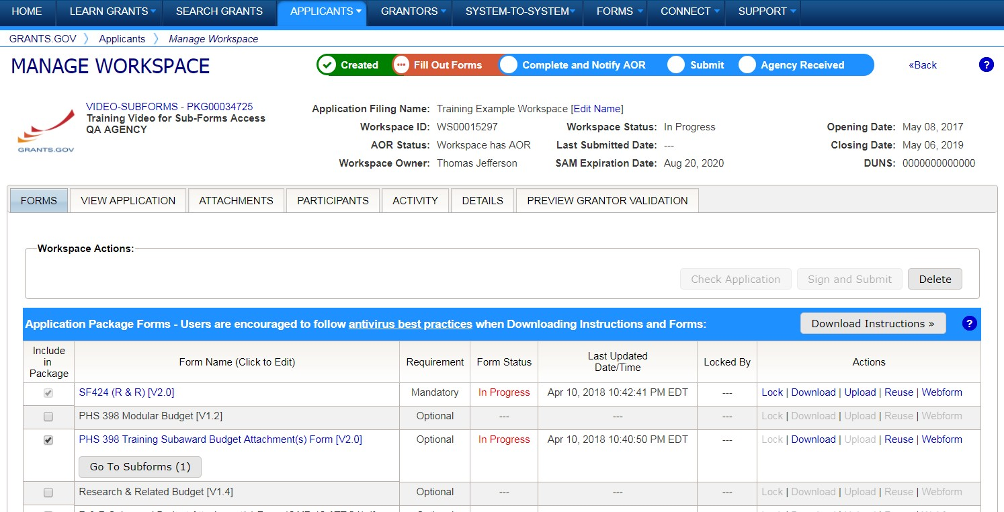
Completing Workspace Forms
Key Actions:
Fill out webforms (if available)
Download and Upload PDF forms
Lock/Unlock forms
Reuse forms from other workspace

Slide 30
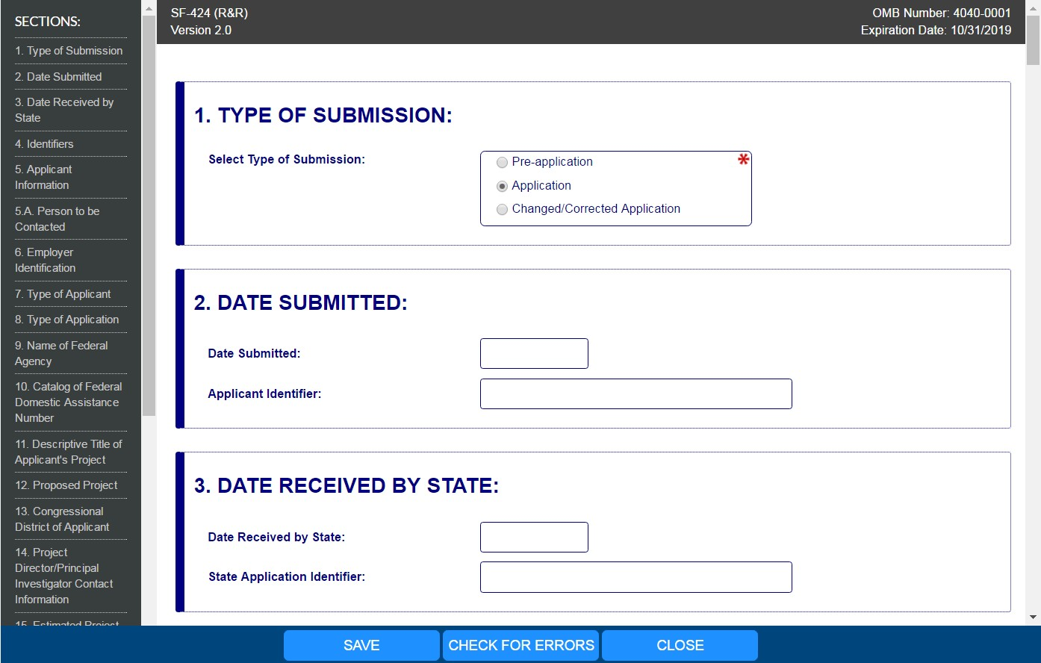
Completing Webforms
Webform Basics:
Complete online forms in web browser
Navigate by clicking sections
Tab through form
fields
Required fields have red asterisk

Slide 31
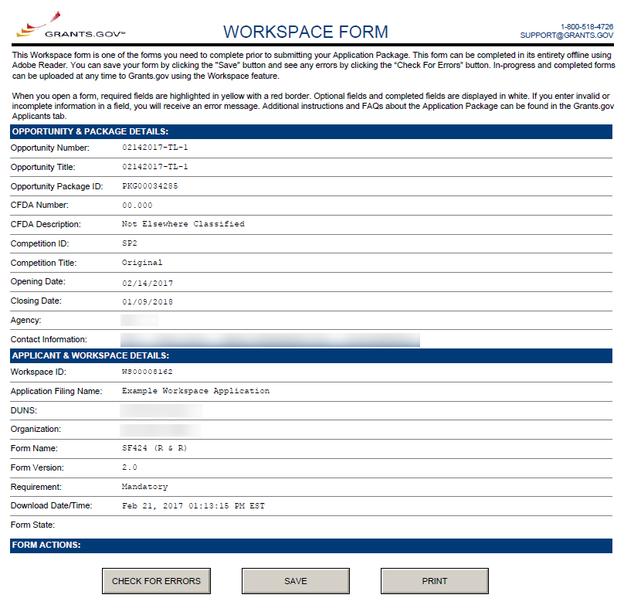
Completing PDF Forms
PDF Form Basics:
Option to download PDF forms to complete in Adobe software
Upload PDF forms to workspace
Upon uploading, data shared between online and PDF versions of forms

Slide 32
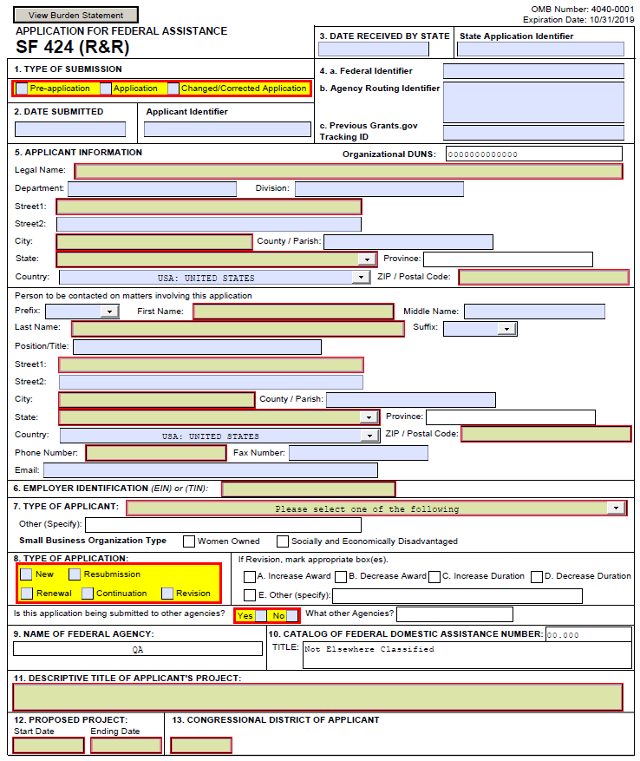
Completing PDF Forms
PDF Form Basics:
Tab through form fields
Required fields have red border and yellow shading
Hover mouse over form fields for help
Error messages explain how to fill out form fields

Slide 33
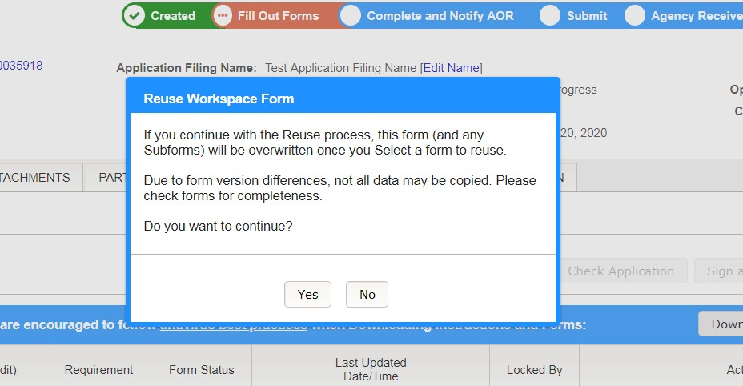
Reusing Workspace Forms
Click Reuse link to import a form from another workspace
Reusing an old form will overwrite all current form data

Slide 34
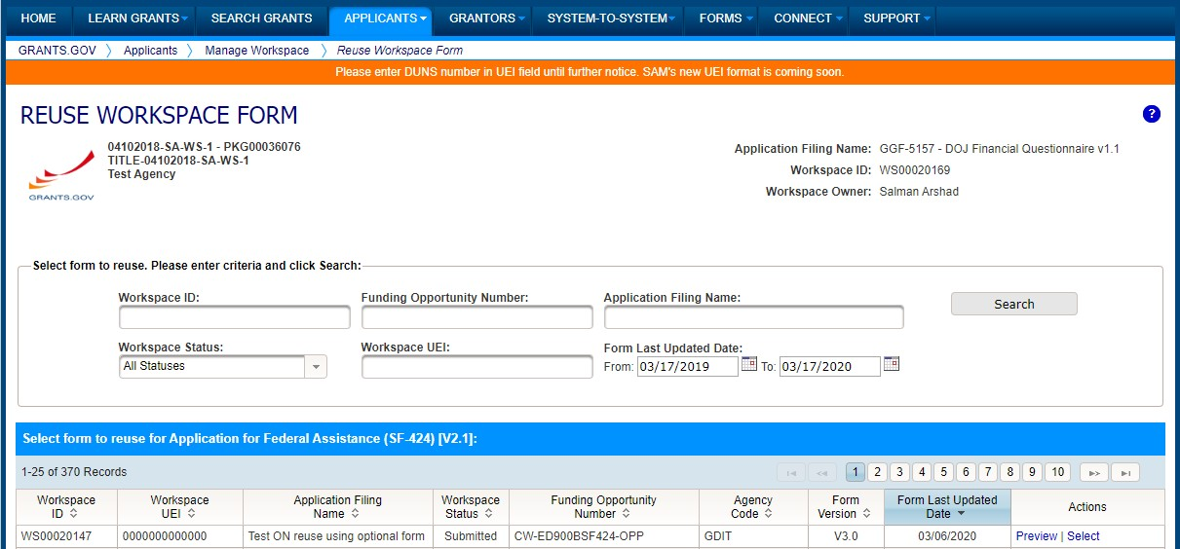
Reusing Workspace Forms
Search through past workspace forms with the same form title
Click Select to import that form into workspace

Slide 35
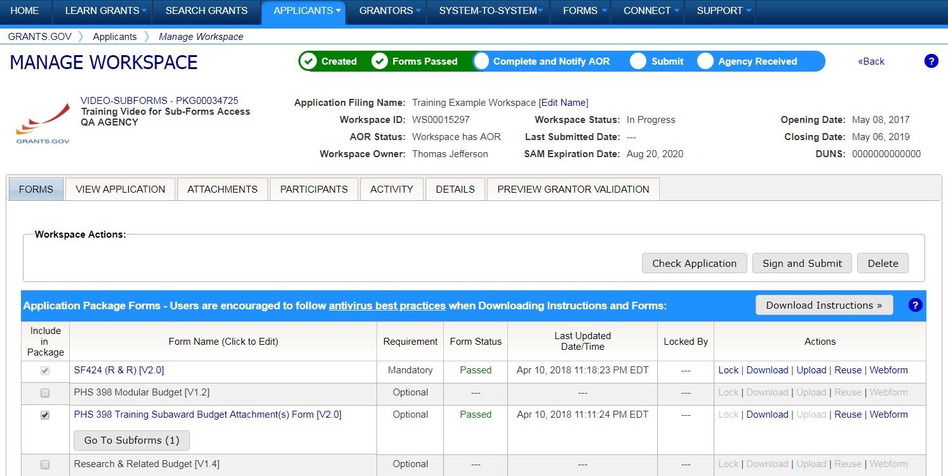
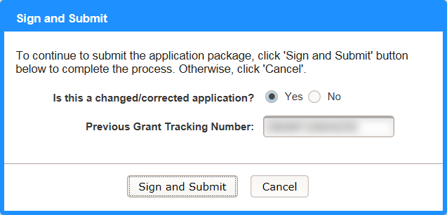
Workspace: Submit Application
Process:
Workspace Manager notifies users with AOR role
User with AOR role submits
Workspace Manager or AOR may choose to Reopen Workspace

Slide 36
Tracking Your Application Submission

Slide 37
Submission Confirmation Messages
Grants.gov Submission Receipt Email
Your application has been received by Grants.gov
Grants.gov E-mail Verifying Receipt (with Track My Application URL)
Grants.gov Submission Validation or Rejection Email
Grants.gov E-mail Verifying Successful Submission
OR Rejection Due to Errors with a description of issue
Transmission to Agency
The Agency has received the Agency Retrieval Email from Grants.gov
Agency Emails
The Agency may also send you an agency tracking number, notes, or other
confirmation emails

Slide 38
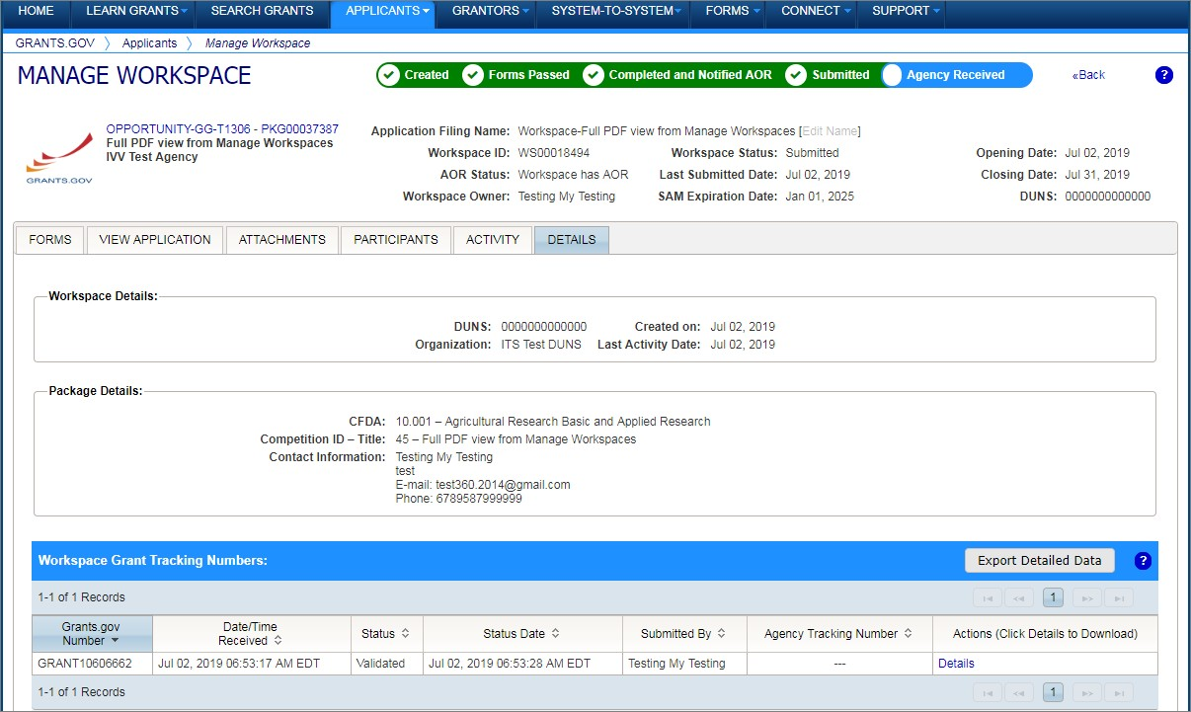
Tracking Your Application
Details Tab of Submitted Workspace
Track your application status and information by accessing the Details tab of the submitted Workspace
Click on the Details link to view the Submission Details

Slide 39
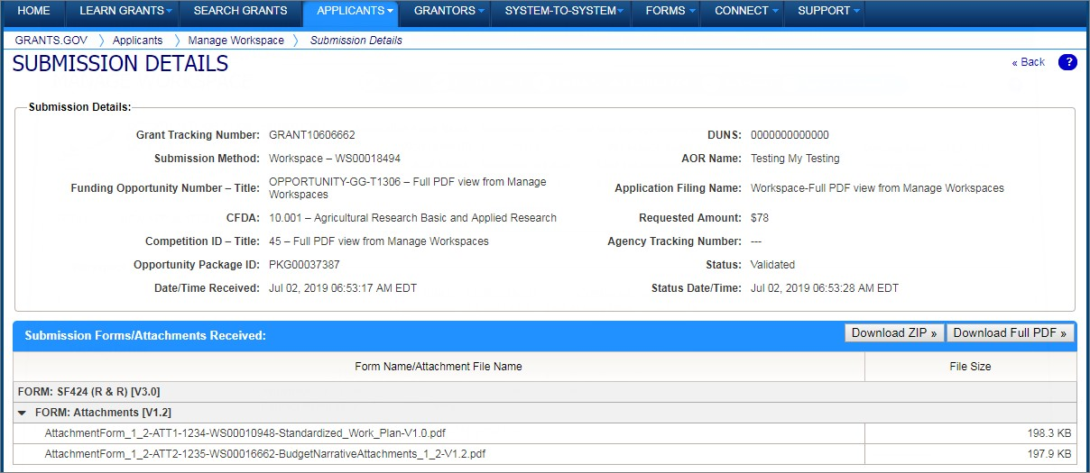
Tracking Your Application
Submission Details of Submitted Workspace
Download ZIP provides a zip file of the submission
Download Full PDF provides a single PDF file of the submission

Slide 40
Grants.gov Mobile App

Slide 41
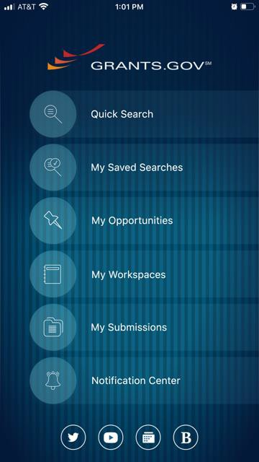
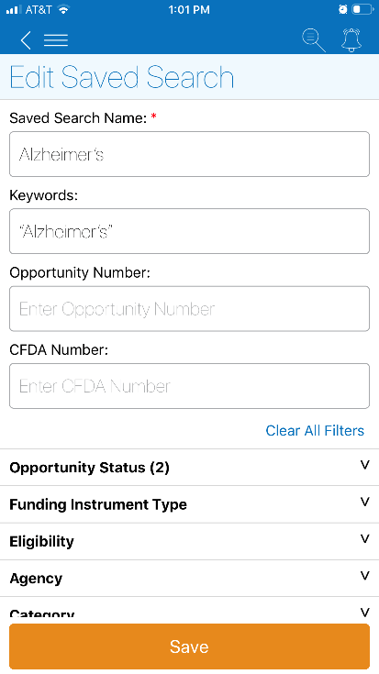
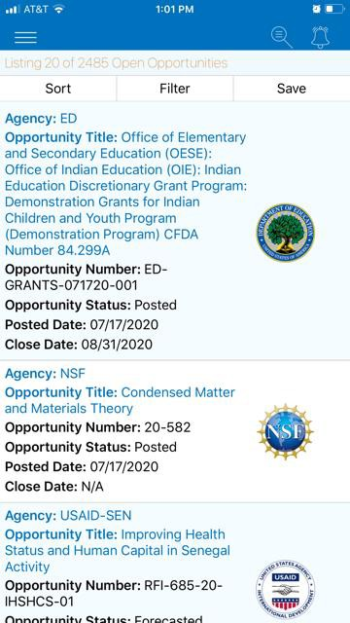
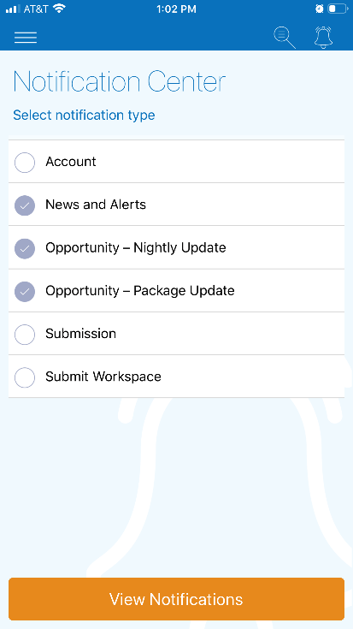
Download the Mobile App
Key Actions
Search for grants on the go
Add and edit Saved Search queries
Receive Notifications about new opportunities and submitted applications
Submit completed applications within the app
Available on Google Play and Apple’s App Store

Slide 42
Tips for Applicants

Slide 43
Tips for Applicants
Crafting Grant Proposals and Submitting Applications
Register and submit early
Thoroughly read and follow all of the instructions provided by the agency
Fill out SF-424 forms first
Include sufficient program and budget
Details
Attachment file names must be 50 characters or less and only contain UTF-8 characters
Use correct UEI (Unique Entity Identifier) when creating a workspace
Make sure you have Grants.gov compatible PDF software (Adobe Reader)

Slide 44
Connect with Grants.gov
Applicant Support Center available 24/7 (closed on Federal holidays)
support@grants.gov | 1-800-518-4726 (toll-free) | 1-606-545-5035 (international)
Follow us on Twitter: @grantsdotgov
Video tutorials on YouTube
Subscribe to our blog:
Blog.Grants.gov
Bookmark for
System Alerts
?
Bookmark our
Online Help
Email Newsletter & Alerts:
Community@grants.gov
Grants.gov Mobile App

